Slide 1

Denoising Algorithms

Slide 2
Problem
Measurement will always introduce noise.
Noise will effect the precision of algorithms and alter the process of training.

Slide 3
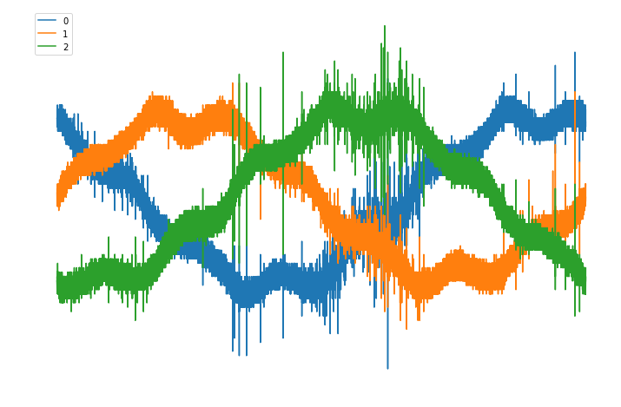
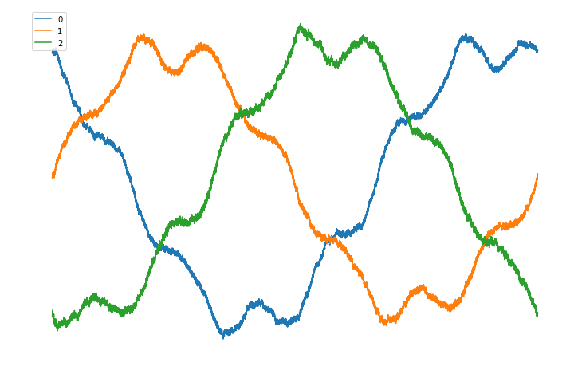
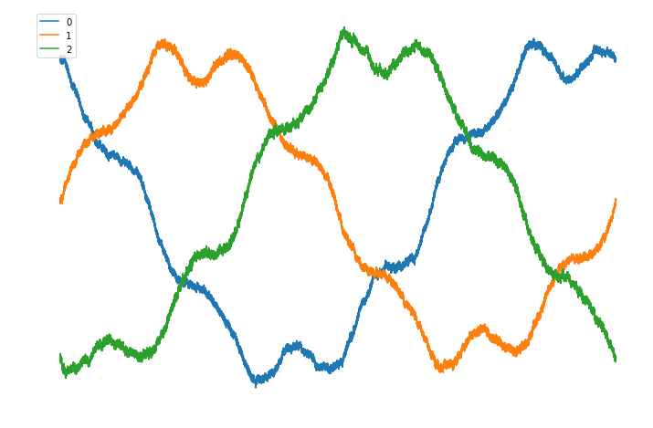
Traditional Algorithms
Rolling Window Average
Savitzky Golay Filter

Slide 4
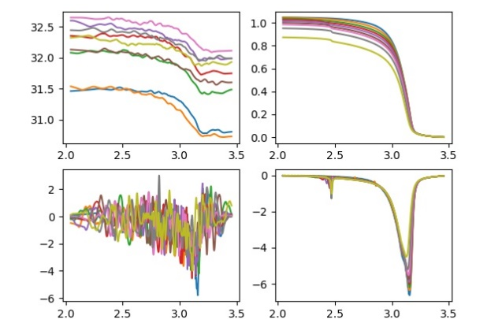
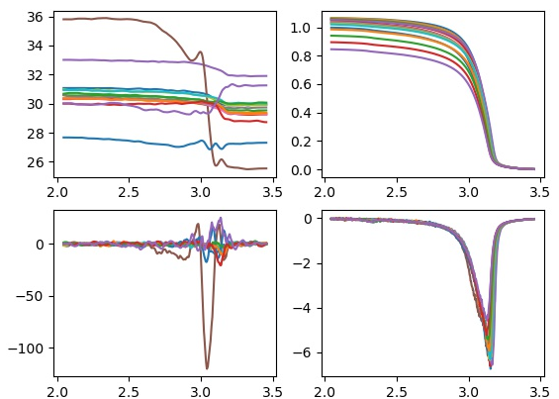
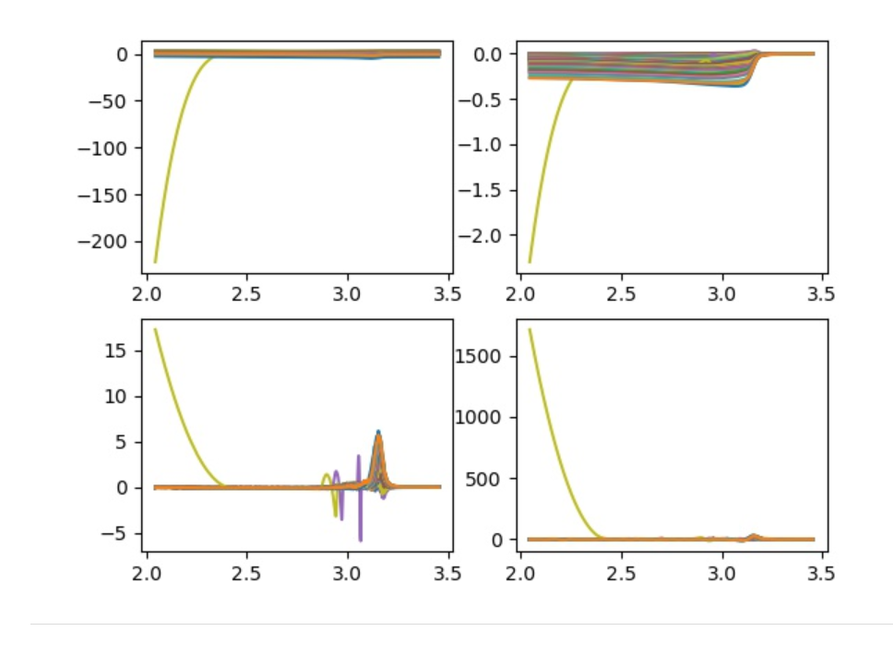
Restrict
Abnormal data.
Some extreme data will change a whole area of data.
Directly delete the data will cause null value.
Some time the denoising process will eliminate the feature we want.

Slide 5
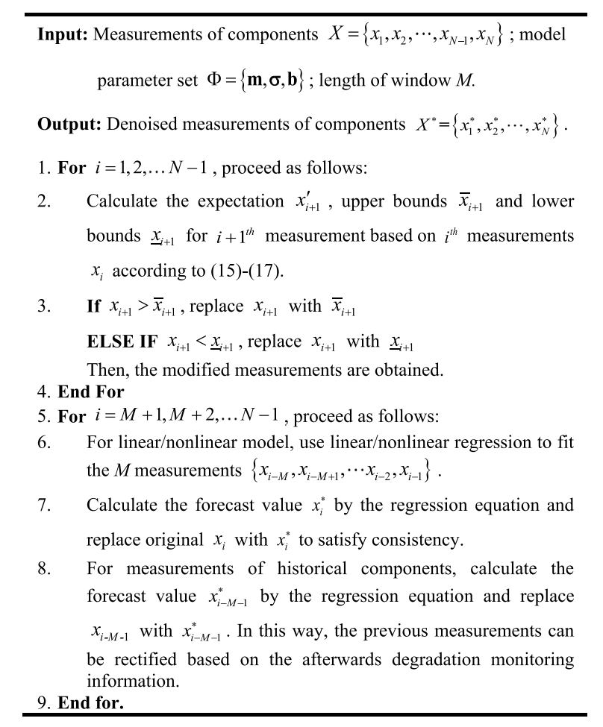
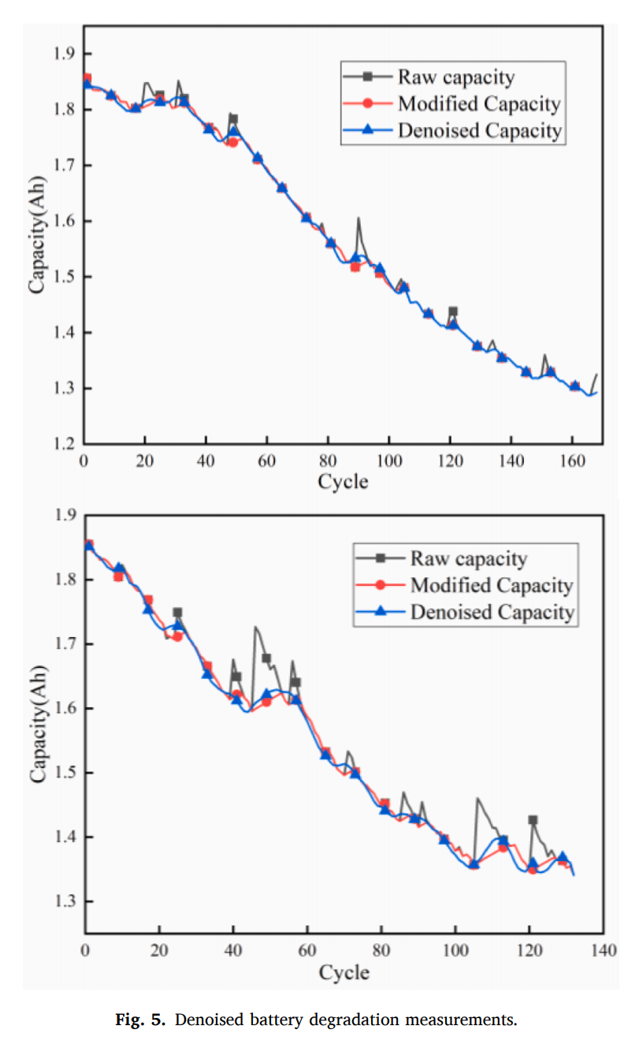
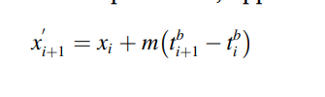
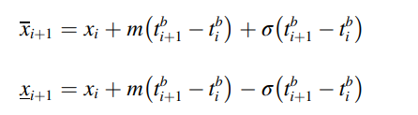
Gauss-Process and Look back update
[1] Zhang, S. J. , R. Kang , and Y. H. Lin . "Remaining useful life prediction for degradation with recovery phenomenon based on uncertain process - ScienceDirect." Reliability Engineering & System Safety (2021).

Slide 6
Gauss process
Denote the true data at time t as x(t) and the measured data at t as X(t)
x(t)=f(x(0),x(1),x(2), … , x(t-1))
Simplify the process a Markov Chain, then x(t) only depends on x(t-1)
x(t)=g(x(t-1)) and X(t)=x(t)+e(x(t)), where e(x(t)) follows a N (x(t) , s)
Determine the most common interval X(t) can be in, if X(t) is outer the interval. Substitute X(t) with the bound of the interval.
The determination of the interval is hyperparameters that can be self-adapt according to historical data in the same procedure and parallel processes.
This is used to settle abnormal data.

Slide 7
Look back principle
If the abnormal data appears in the very early stage, it will be hard to detect and solve.
We can use linear or non-linear regression to find the trade of the data and update backwards.
The parameter of the regression also comes both from similar process and itself.

Slide 8

Thank you!

Slide 9
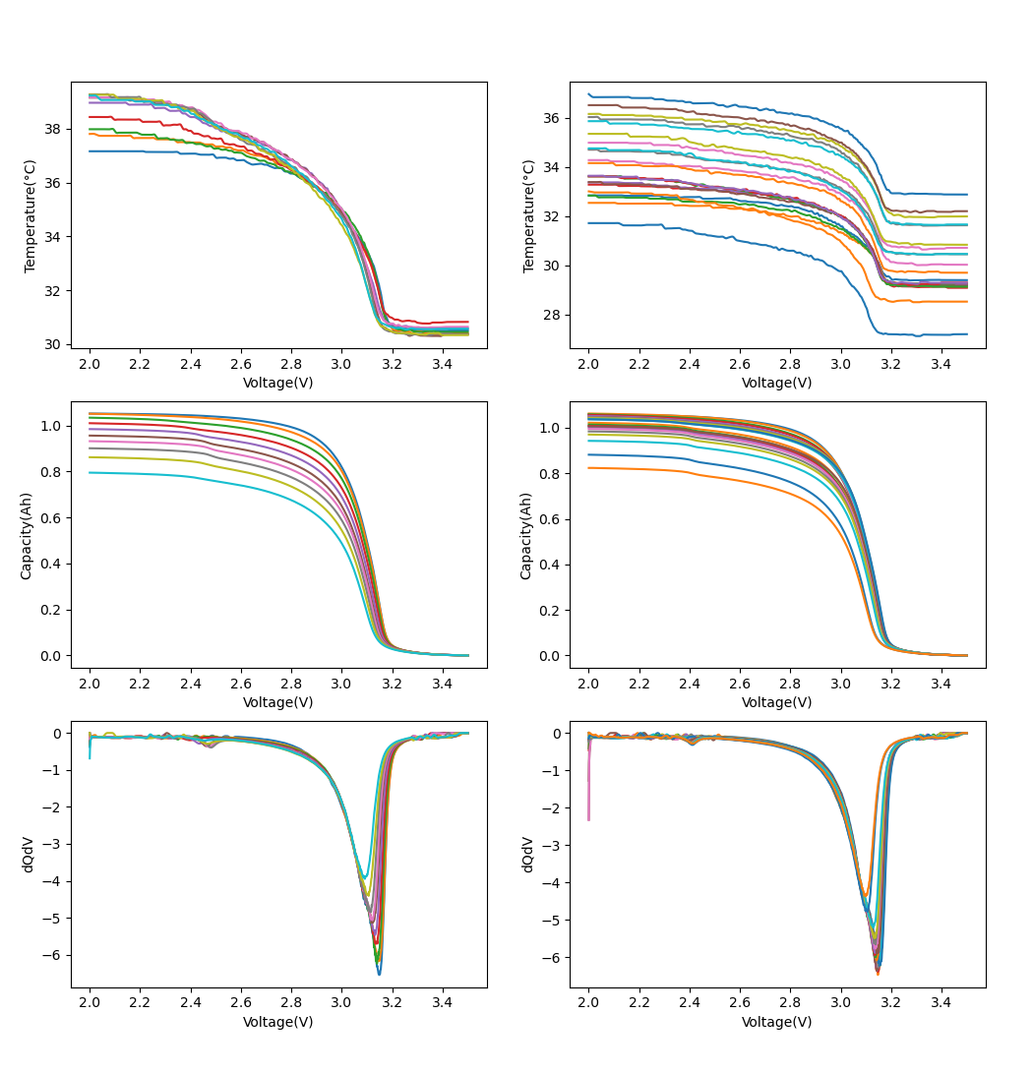
Cycle Increase
Cycle Increase
Cycle Increase
Cycle Increase
Cycle Increase
Cycle Increase

Slide 10
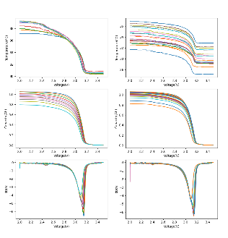
Original Data
Denoising Process
Feature Extraction

